Slide 1
The role of the state in economic development
Wolfgang-Peter Zingel
Associate Member
South Asia Institute of Heidelberg University
Abhilashi University
Mandi, Himachal Pradesh
29 October 2018

Slide 2
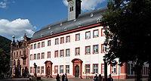
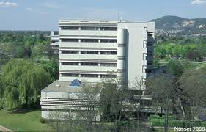
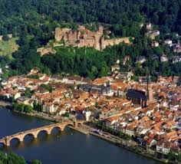
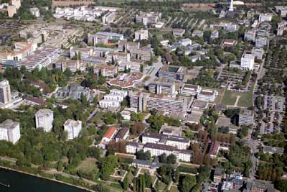
South Asia Institute of Heidelberg University
Departments:
Economics
Anthropology
Geography
History
Indologiey
Languages
Political Sciences
SAI
SAI Library holds
260,000 titles on South Asia.

Slide 3
Background
The presenter is a trained economist with a background in international comparative agricultural policy and rural sociology. He started teaching European Common Agricultural (CAP), especially market and price policy, and reviewing and programming German development assistance.
He has worked all over South Asia, mainly on (mega-)urbanization, regional cooperation, economic growth and distribution.
He had been teaching public finance at the Department of Economics of Himachal Pradesh University at Shimla and has been visiting scholar at the Academy of International Studies of Jamia Millia Islamia, New Delhi.
He is Associate Member of the South Asia Institute of Heidelberg University, Germany, where he has been working since 1971.

Slide 4
The task
Economic textbooks start on a high level of abstraction:
One or two products, produced by one or two production factors,
Total information, neither time nor space, rational behaviour, etc.
Only at a later stage the state is introduced as an actor. Much of the discussion concentrates on the question of the particular advantages of private versus public and the roles of markets and the state.
If the economy is considered as a game, the state is the one who organizes the game, he sets the rules of the game, is the umpire and penalizes any offences against the rules of the game.
But more than often the state is also a (major) player in the game, which means that he has to control himself.

Slide 5
Who or what is the state?
In real life, however, it is difficult to describe who or what the state actually is.
For example:
In most countries you need a driver’s licence that allows you to drive a motor vehicle. The licence is usually granted by a government office, on the condition that the driver is physically fit to do so, or if short sighted, needs glasses. The eyes are examined by a private doctor, who himself needs some state approved qualifications. Such he becomes part of the state apparatus.
There are many more such examaples.

Slide 6
Private and public goods
Simple economic models deal with private goods, i.e. goods provided by private actors.
But there are so called public goods that usually are characterized by external effects and/or constitute natural monopolies because of high fixed costs.
Example: It would make no sense to have three parallel irrigation canals competing. We rather have one that has a monopoly, which needs regulation.

Slide 7
The state in a multi-level set-up
India and Germany are federal states with several levels of political and administrative organization.
The set up follows the principle of subsidiarity, which means that things are to be organized on the lowest possible level.
This can be understood locally/regionally like in a village-district-state-union set-up, but also socially/culturally in a sense that each group runs their own schools, hospitals etc.

Slide 8
Non state actors
Often overlooked are para-statals, semi-government, not for profit, charitable organizations, trusts, NGOs.
There is a whole lot of institutions that are not strictly private or public, especially in the services sectors, often enjoying far reaching privileges and rights, if we only think of traditional rights to common resources.

Slide 9
Holding state and economy together: State and non-state actors
State:
Federal, provincial and local governments
The army: a state within the state?
The judiciary (sui moto)
Non-state:
Families, clans, tribes: networks, collective bargaining
Private business
A ‘formal informal economy‘
Charitable and religious institutions, NGOs
Para-statals:
Utilities (providing water, power, transport)
Economic undertakings of the army

Slide 10
International aspects
When it comes to international trade, the state becomes a prominent actor. This especially applies to quantitive restrictions, taxes on imports and exports, non-tariff rules etc.
Historically, regulating imports and exports of agricultural commodities must have been the beginnings of trade policy.
As always there are winners and losers: Producers favour import restrictions, while consumers would benefit most from a free trade regime. A perfect example is the fight over the onion trade in India.

Slide 11
Conclusion
The role of the state in economic development is seen differently by different interest groups.
Markets, if let totally unregulated tend to favour monopolies, where the monopolist realizes his monopolistic gains at the cost of quantity and quality.
Beyond that the state can have a leading role, e.g. in encouraging technical progress, but also guarantee a sustainable and eco-friendly development.

Slide 12
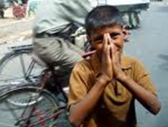
Thank you very much for your attention Comments, questions: h93@ix.urz.uni-heidelberg.de Texts of Wolfgang-Peter Zingel: http://www.sai.uni-heidelberg.de/abt/intwep/zingel/

